Slide 1


Breast cancer prediction

Slide 2
TEAM
Bala Sujith Reddy Basani
700742601
Sharmila Spoorthy Pothireddy
700741830
Ruchitha Ekkaladevi Srinivas
700742174
Ranjith Rao Jupalli
700733541

Slide 3
Roles and responsibilities
Team member | Task 1 | Task 2
Bala Sujith | Data Cleaning
Spoorthy | Data Analysis | Review of the project
Ruchitha | Tools and technology | Applyung Dymensionality
Ranjith | Communicating Responsibilities | Documenting the results

Slide 4
Problem statement
Breast cancer is a condition where the growth of the cell is abnormal. There are multiple screening methods available to find breast cancer like mammogram, breast ultrasound, breast examination and Fine Needle Aspiration(FNA). Out of all the methods FNA is considered to be the definitive method to rule out the cancerous cells in the breast. The process of FNA includes collecting breast tissue from the suspected area with the help of the needle and this is studied under the microscope. Data to predict the cancer comes in multiple dimensions. In our dataset we have 32 real-valued features computed for each cell nucleus.These features include radius, texture and concavity parameters.To analyze the huge number of parameters and looking for patterns is difficult for traditional methods.

Slide 5
Proposed solution
Data to predict the cancer comes in multiple dimentions.In our dataset we have 32 real-valued features computed for each cell nucleus.These features include radius, texture and concavity parameters.To analyze the huge number of parameters and looking for patterns is difficult for traditional methods. Machine learning methods solve the problems of multi dimensional data easily with pattern recognition as the core responsibility.Recent studies have shown that we can gain 95% accurate results on the Wisconsin Breast Cancer dataset with machine learning methods. Since the manual methods consume more time, automating the task makes the process easy.Methods to arrive at the solution to this problem are PCA and LDA. Principal Component Analysis and Linear Discriminant Analysis methods are used to reduce the dimensions of data

Slide 6
Objectives
The main objectives of our project are:
Reduce the dimensionality using PCA and LDA
predict or classify the type of the cancer benign or malignant using machine learning classifiers.
If the predicted class is benign that means the lump is non cancerous this could be due to hormonal changes.Medical examination is suggested for further changes.If the disease is malignant it says the presence cancerous cell in the breast and the further steps are finding the stage of the cancer for appropriate treatment.

Slide 7
Motivation
Breast cancer is a condition of abnormal growth of the cells in the breasts. The anatomy of the breast focuses on 3 main parts: lobules, connecting tissues and ducts.Lobules produce the milk, ducts carry the milk to the nipples and connecting tissues bind it together.There are different kinds of breast cancers in nature.The type of the cancer depend on where in which it started.Most breast cancers are seen in the lobules. Breast cancer can spread to the outer parts of the breast.Once the patient starts to see the symptoms like a lump in the breast and blood discharge from the breasts the next step is to screen the breasts.There are multiple screening methods available to find breast cancer like mammogram, breast ultrasound, breast examination and Fine Needle Aspiration(FNA).Out of all the methods FNA is considered to be the definitive method to rule out the cancerous cells in the breast. The process of FNA includes collecting breast tissue from the suspected area with the help of the needle and this is studied under the microscope.

Slide 8
Related Work
Usually medical data contains a vast number of features after the clinical processes.Since we can not diagnose the disease with the limited number of features.However, training the model with high dimensional data leads to overfitting of the model[2]. Early prediction of breast cancer in women is the major challenge in the medical industry.Prediction of disease through FNA screening features is a cumbersome process due to high dimensionality.Integrating the traditional machine learning algorithms with the PCA technique reduces the dimensions.Cumulative proportion of 92% of the information is gained from major components [1]. PCA finds the direction of samples with maximum variance irrespective of class.PCA is unsupervised learning technique.For reducing the dimension of the features class separability i.e.taking consideration of classes is also important.So to perform this task we are implementing LDA(Linear Discriminant Analysis) which is supervised machine learning technique[3]. With the implementation of the SVM(Support Vector Machine) classifier we can achieve 99.8 % of accuracy.To measure the performance of the test data crossfold validation is implemented and the performance is recorded for the 10 folds.

Slide 9
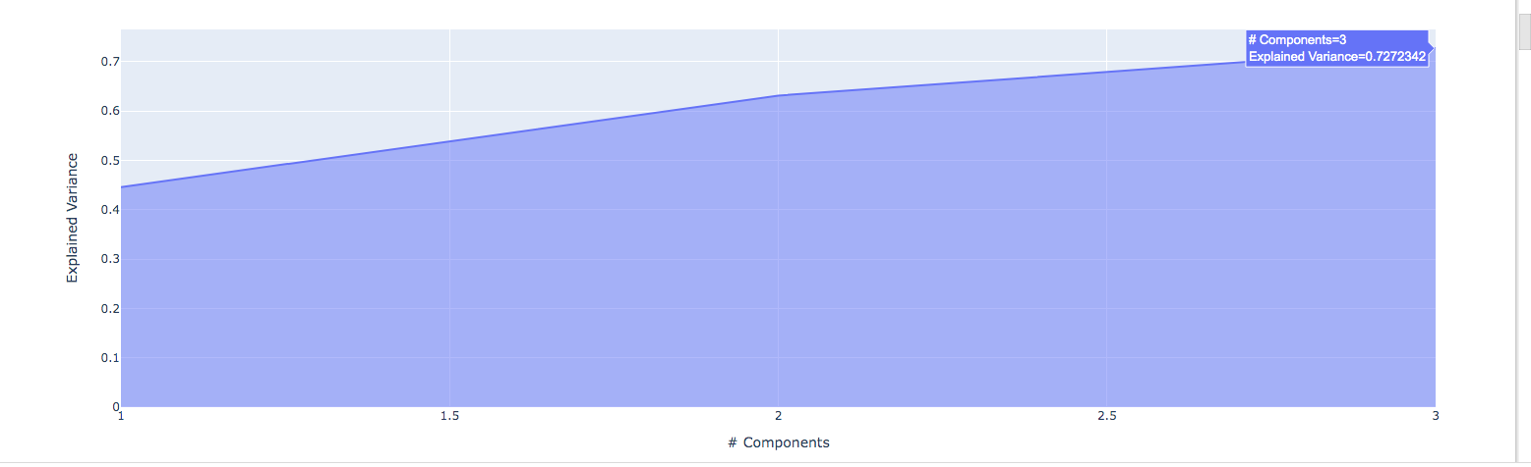
Results
With 3 principal components we have achieved explained variance of 72%

Slide 10
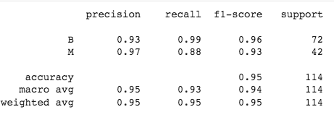
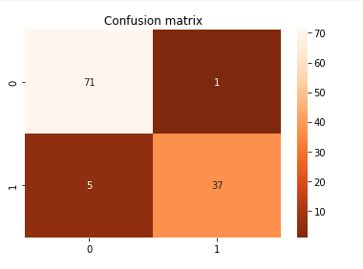
Results
The above figures show classification report and confusion matrix for logistic regression(PCA)
Logistic regression achieved 95% accuracy on test data
Malignant class has the highest precision and benign class has highest recall and F1 score
There 6 incorrect classifications out of 114 samples

Slide 11
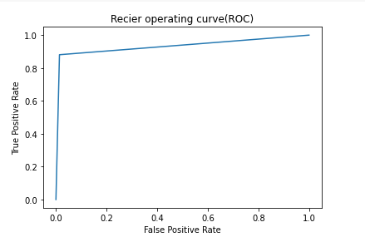
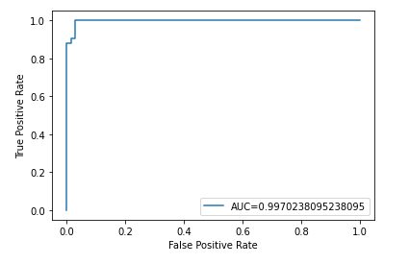
Results

Slide 12
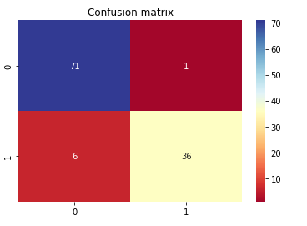
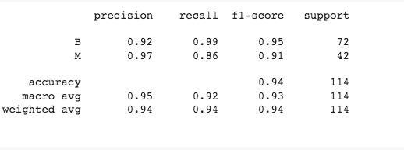
Results
The above figures show classification report and confusion matrix for SVM(Support Vector machine) with (PCA)
SVM achieved 94% accuracy on test data
Malignant class has the highest precision and benign class has highest recall and F1 score
There 7 incorrect classifications out of 114 samples

Slide 13
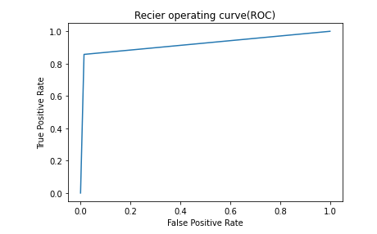
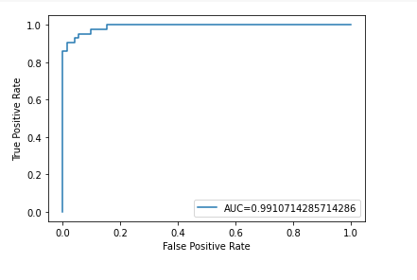
Results

Slide 14
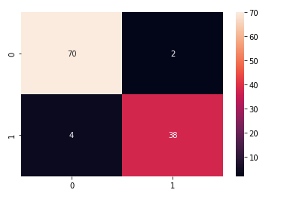
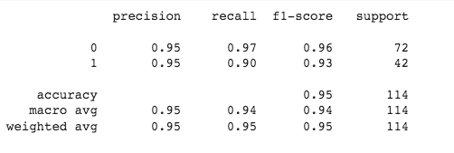
Results
The above figures show classification report and confusion matrix for Logistic Regression with (LDA)
SVM achieved 95% accuracy on test data
Malignant class and benign has the same precision and benign class has highest recall and F1 score
There 6 incorrect classifications out of 114 samples

Slide 15
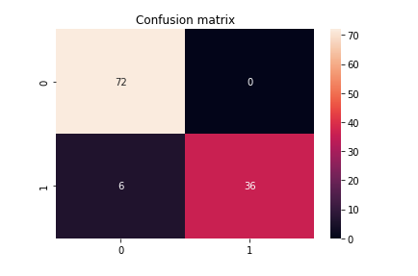
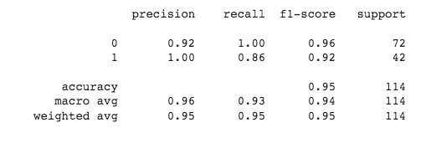
Results
The above figures show classification report and confusion matrix for SVM(Support Vector machine) with (LDA)
SVM achieved 95% accuracy on test data
Malignant class has the highest precision and benign class has highest recall and F1 score
There 6 incorrect classifications out of 114 samples

Slide 16
Results-summary
In essence, Logistic regression and SVM algorithms performed similarly in terms of accuracy and other metrics like precision, recall and F1 score
 | Logistic regression | SVM(Support Vector Machine)
PCA | 95 % accuracy | 94 % accuracy
LDA | 95 % accuracy | 95 % accuracy

Slide 17
References
[1].H. -J. Chiu, T. -H. S. Li and P. -H. Kuo, "Breast Cancer–Detection System Using PCA, Multilayer Perceptron, Transfer Learning, and Support Vector Machine," in IEEE Access, vol. 8, pp. 204309-204324, 2020, doi: 10.1109/ACCESS.2020.3036912.
[2].B. Hariharan, P. N. S. Prakash, C. G. Anupama, R. Siva, S. Kaliraj and W. B. N.R, "Dimensionality Reduction based Medical Data Classification using Hybrid Linear Discriminant Analysis," 2022 3rd International Conference on Electronics and Sustainable Communication Systems (ICESC), 2022, pp. 43-48, doi: 10.1109/ICESC54411.2022.9885728.
[3].E. O. Jessica, M. Hamada, S. I. Yusuf and M. Hassan, "The Role of Linear Discriminant Analysis for Accurate Prediction of Breast Cancer," 2021 IEEE 14th International Symposium on Embedded Multicore/Many-core Systems-on-Chip (MCSoC), 2021, pp. 340-344, doi: 10.1109/MCSoC51149.2021.00057.
[4].E. O. Jessica, M. Hamada, S. I. Yusuf and M. Hassan, "The Role of Linear Discriminant Analysis for Accurate Prediction of Breast Cancer," 2021 IEEE 14th International Symposium on Embedded Multicore/Many-core Systems-on-Chip (MCSoC), 2021, pp. 340-344, doi: 10.1109/MCSoC51149.2021.00057.

Slide 18

THANKS!
Any questions?

